Slide 1
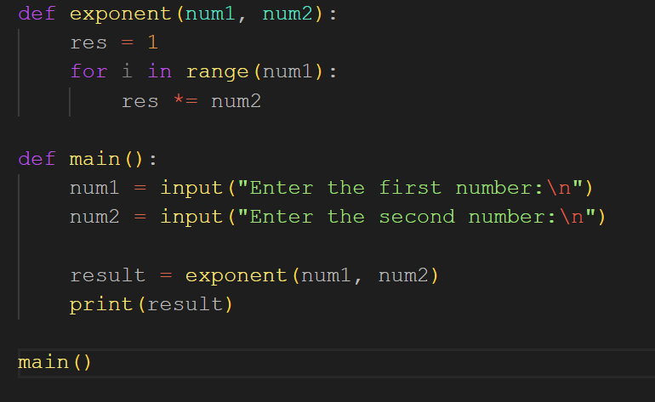
Icebreaker Activity: Find The Bug!
Once found, discuss correct alternative implementations with your table groups!

Slide 2
APIs With Python
Hack Night Workshop #6!

Slide 3
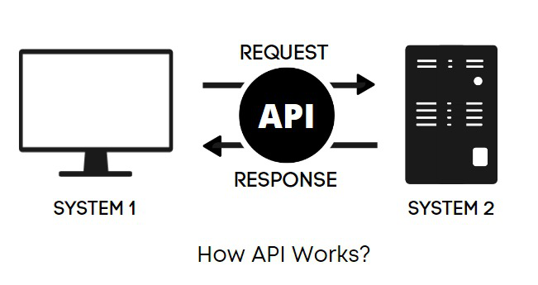
What is an API?
Software that allows computers to talk to one another!
Today, we’ll discuss REST APIs
Let’s start with an example
Notes:
APIs are software that allows two applications to talk to each other
They are used when information/data from one app is needed in another
REST - REST is a software architectural style that was created to guide the design and development of the architecture for the World Wide Web. REST defines a set of constraints for how the architecture of a distributed, Internet-scale hypermedia system, such as the Web, should behave.

Slide 4
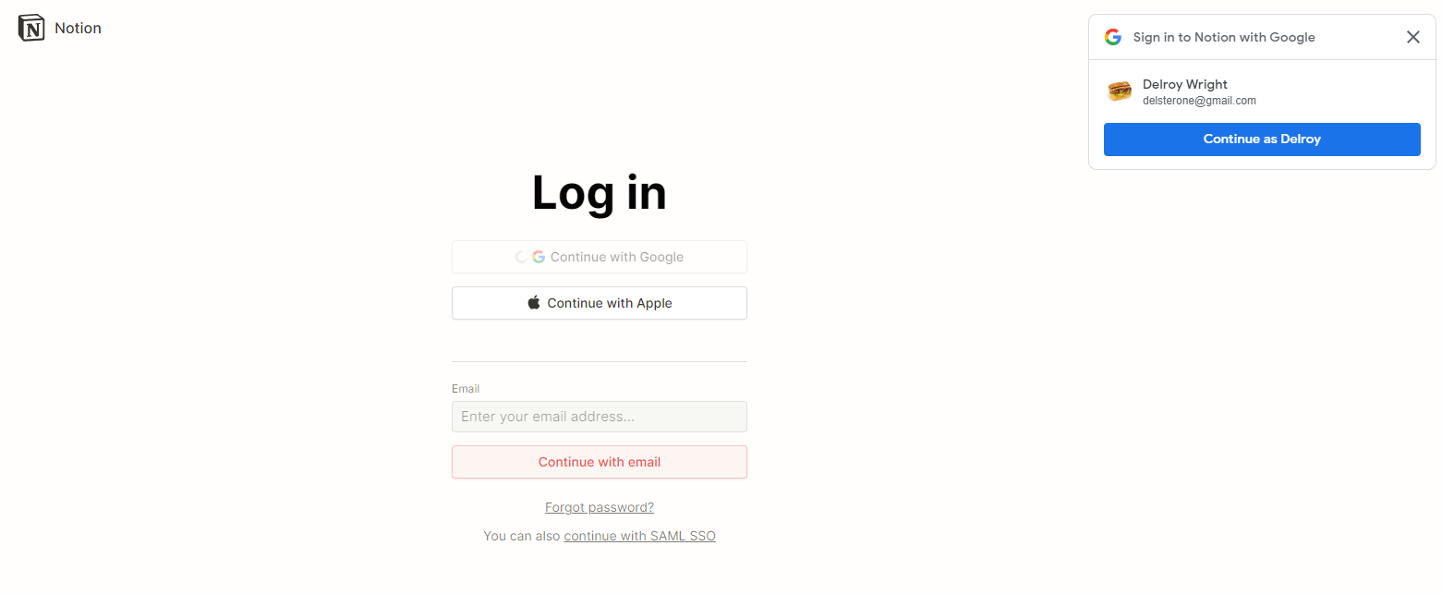
For Example…
Notes:
As seen here, APIs make logging in is a fairly simple process. All I have to do to login to notion is login using my google credentials and voila!
Here, Notion is using google’s API to authenticate your user and therefore authorize a login to Notion.
This seems like a fairly simple process, but let me explain what is really going on.

Slide 5
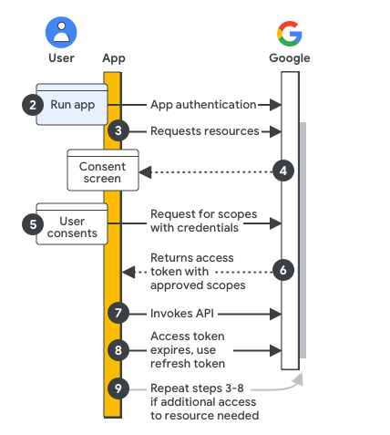
How it works:
Notes:
If we think of this as a conversation, and start at 2.
Pretend google and notion are walking down the street towards eachother. Notion wants some information from google. This diagram is their conversation.
At number 1, Notion and google are walking down the street towards eachother.
At number 2, google recognizes notion as a friend! rather than a stranger or enemy
At number 3, Notion says “hey google! I’d like to talk to you.”
At number 4, Google checks his brain to know if he’s allowed to talk to Notion, and realizes that he can!
At number 5, Notion asks if he can ask Google about x. Think of this like asking a professor if your allowed to ask something during a test.
At number 6, Google says yes! You can ask me about x.
At number 7, Notion asks google for some information with the given permission and google responds
At number 8, Google walks away, so that no more information can be shared
Here, the step we want to focus on is step 7. In this step, google gives notion an access token (which we’ll get into later) through google’s API that notion then uses to authenticate your user, and log you in
The important thing here is: once we have authenticated with a server and we have the necessary access tokens and credentials, we can then invoke an API.

Slide 6
More Examples of APIs
01
02
Recieptify
Pay with PayPal
03
04
Trivago
Third Party Stock Tracking Apps

Slide 7
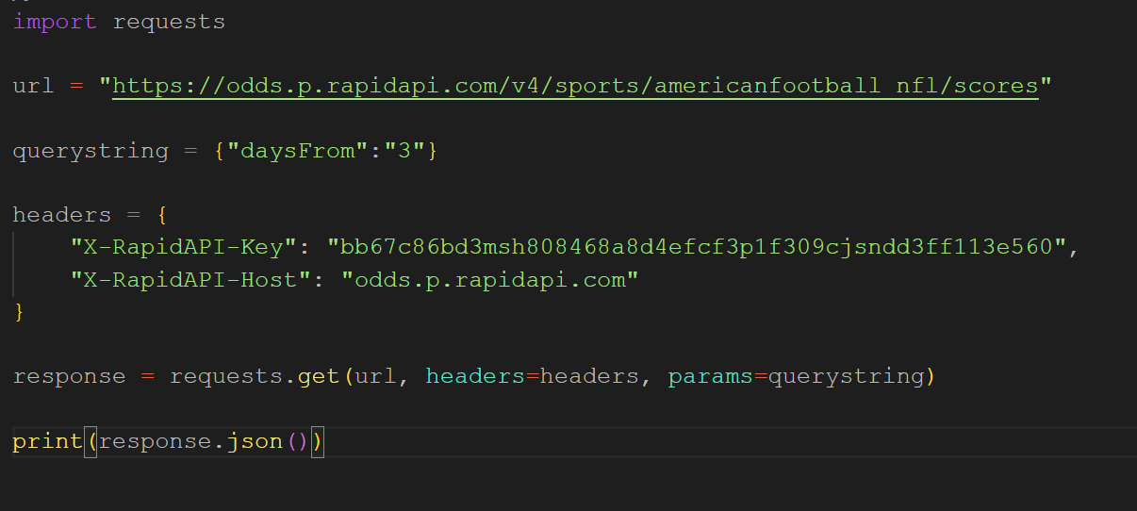
How do I use APIs in Python?
Python Library: Requests

Slide 8
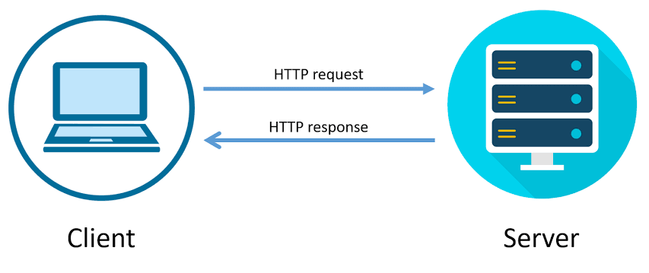

What are Requests?
Requests are HTTP Requests.
HTTP requests are messages sent by a client (such as a web browser) to a server to initiate a specific action or request a particular resource.
HTTP is the foundation of any data exchange on the Web, and it operates on top of the TCP/IP protocol.

Slide 9
Code Snippet

Slide 10
Let’s Break This Down:
https://odds.p.rapidapi.com - Host - Domain or Server where a resource is located
/v4/sports/americanfootball_nfl/scores - URI - Path to the resource on the server.
The URL specifies a host and specific location on a host.

Slide 11
Let’s Break This Down:
Here, we use the HTTP Verb: GET. We use GET, because GET requests retrieve data from a specified resource.
This is not the only HTTP Verb though, there are other ones that are useful when working with HTTP Requests
GET - Requests data from a given resource
HEAD - Similar to GET, but only returns response headers.
POST - Submits an entity to the specified resource.
PUT - Replaces all data at a target with the request’s payload.
DELETE - Deletes data at a specified resource
TRACE - Performs a loop-back test for debugging.

Slide 12
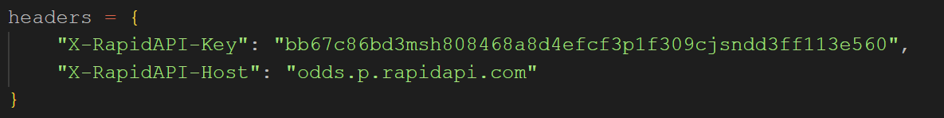
Let’s Break This Down:
Headers provide information about the request. They can add context about what is being communicated, specify a destination, provide a framework for authorization, and much more. Headers can do almost anything a developer designs them to, they’re often used to build or expand functionality.
Here, the headers are used to pass an API key and host to my API request. We’ll get into more of what these are doing later.

Slide 13


Let’s Break This Down:
≈ ≈
The querystring variable contains Query Parameters. These are used for filtering, sorting, or providing additional information about a request.
You’ve seen these before - Canvas Calendar Example
The Total Request URL would be:
https://odds.p.rapidapi.com/v4/sports/americanfootball_nfl/scores/?daysFrom=3.

Slide 14
API Keys and Authorization
So, what was all that about API Keys, Hosts, and Access Tokens?
API Keys allow the server to identify the program making the request. They are used for:
Identification
Access Control
Security
Access tokens are credentials that authenticate and authorize a client to access specific resources on an API.
They are obtained through authentication processes like OAuth2.0, and are commonly included in API requests to validate the client's permissions.
.
Notes:
API Keys are something you’ll definitely come across when working with APIs. Before working with an API, you might have to register to retrieve an API key.
Access tokens play a crucial role in ensuring secure and controlled access to API resources

Slide 15
Using requests with APIs
Let me show you how easy it is to use an APIs in your python code:
https://rapidapi.com/collection/list-of-free-apis - USE FREE API
https://github.com/public-apis/public-apis
see file:
~/Onedrive/Documents/compsci/bugSmashers/APIs/showcase.py

Slide 16
Make your first API request
Go try it out!
https://rapidapi.com/collection/list-of-free-apis
htps://github.com/public-apis/public-apis

